Slide 1
Java Exceptions: API Design is Hard
Checked exceptions are widely recognized as a poor design decision these days
Unchecked (aka runtime) exceptions are fine
Predates some important lessons/best practices in API design (field has advanced in the last 30 years!)
Good example of what happens when you aren’t careful about API design
Hard to use
Nearly impossible to fix

Slide 2
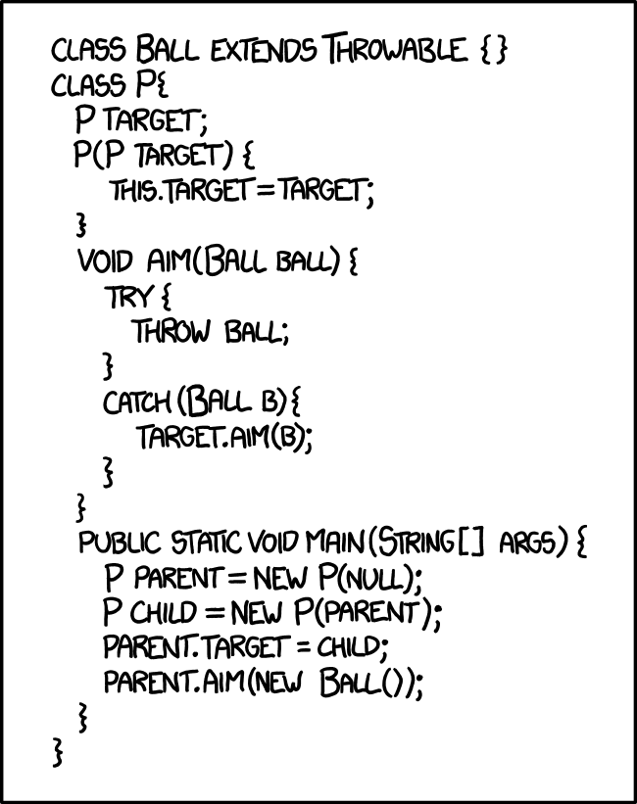
Exceptions (High Level)
When something goes wrong, code will throw an exception
This stops running lines of code and returns up the call stack until it reaches a catch block
This block will handle the exception, typically by one or more of:
Logging the exception
Re-throwing the exception as a different type or with additional information
Returning an error code

Slide 3
Types of Exception
Throwable
Exception
RuntimeException
Error

Slide 4
Checked Exceptions
Anything that is an Exception but not a RuntimeException is a checked exception
These are a mistake of the past: should either use a return status or generic error handling
Must be declared on the method signature
Must be either caught or rethrown by method callers
Most common in practice: IOException

Slide 5
Common Error Types
AssertionError
OutOfMemoryError (OOM)
Typically for things that shouldn't be specifically caught; indicate exceptionally exceptional circumstances

Slide 6
Finally Block
"try this, possibly handle an error if it goes wrong, and finally, do this other thing"
Runs regardless of if an exception was thrown
Throwing an exception in a finally block is really bad:
masks other errors
may leave data in a bad state
very uncharted territory
⇒ use finally cautiously/sparingly

Slide 7
Try With Resources
Alternative to explicit finally block
Avoids resource leak bugs
try (FileReader reader = new FileReader("someFile.txt")) {
reader.readInt();
}
Requires that the object implement Closeable

Slide 8
When To Throw vs Error Codes
Could a client reasonably handle this error specifically?
⇒ Use an error code (in the past: checked exception)
Would any error handling be of a fairly generic 'something went wrong' type?
⇒ throw a RuntimeException (typically, IllegalStateException or IllegalArgumentException)
Are errors common enough that all clients should check for them?
⇒ Use an Optional<> return type, possibly with an error code (in the past: return null/-1)

Slide 9
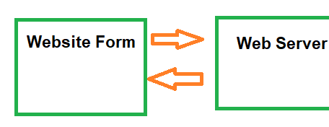
Cross Process/Cross Network Exceptions
Java Exceptions stop propagating at the end of a thread, which includes the edge of a Java Process
No Exceptions past this point

Slide 10
Cross Process/Cross Network Exceptions
At the boundary of a process/network call, always include a
try {
// internal server code
} catch (Throwable t) {
// translate to an error code
}

Slide 11
Stack Traces
All Throwables include a stack trace - this is automatically populated by the jvm
It starts with what line the exception was thrown at, and continues up the call stack with classes and line numbers

Slide 12
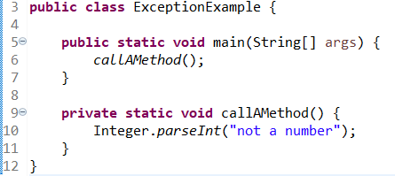
Stack Traces
Exception in thread "main" java.lang.NumberFormatException: For input string: "not a number"
at java.base/java.lang.NumberFormatException.forInputString(Unknown Source)
at java.base/java.lang.Integer.parseInt(Unknown Source)
at java.base/java.lang.Integer.parseInt(Unknown Source)
at pointerExample.ExceptionExample.callAMethod(ExceptionExample.java:10)
at pointerExample.ExceptionExample.main(ExceptionExample.java:6)

Slide 13
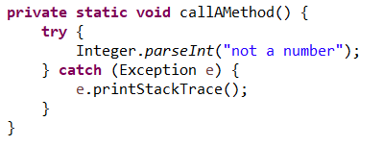
Stack Traces
For uncaught exceptions on the main thread, they will print to the console and end the program (usually)
For caught exceptions, you can do the same with printStackTrace()
In unusual circumstances, you can introspect using getStackTrace()

Slide 14
Error Messages
getMessage() is defined on Throwable, but can be and often is null
⇒ Use constructors to provide a good message when throwing
⇒ Don't assume the message is helpful when catching

Slide 15
Exception getCause()
"Catch and re-throw" is very common
Convert checked → unchecked
Move exceptions across threads
Sanitize error message
Providing the original exception preserves important debugging info

Slide 16
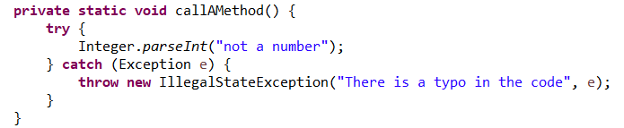
Exception getCause()
Exception in thread "main" java.lang.IllegalStateException: There is a typo in the code
at pointerExample.ExceptionExample.callAMethod(ExceptionExample.java:13)
at pointerExample.ExceptionExample.main(ExceptionExample.java:6)
Caused by: java.lang.NumberFormatException: For input string: "not a number"
at java.base/java.lang.NumberFormatException.forInputString(Unknown Source)
at java.base/java.lang.Integer.parseInt(Unknown Source)
at java.base/java.lang.Integer.parseInt(Unknown Source)
at pointerExample.ExceptionExample.callAMethod(ExceptionExample.java:11)

Slide 17
Let’s Review
Exceptions:
Three different ways to signal errors to a user: Exception, Error Codes/Return Values, Optional
What each is and when to use them
try/catch/finally - syntax and what each block does
try-with-resources - when to use it, why to use it
Generics:
syntax, including ? and ? extends
How the compiler uses this to enforce type safety
When should you add a type parameter
How to use code that has a type parameter

